Slide 1
Closure Properties On Automatic Compile And Design
V. Sidharrdh Reddy
22h51A73C5
SlideMake.com

Slide 2
Introduction
Closure properties in automatic compile and design refer to the ability of a system to perform certain operations and still produce a result within the same system.
These properties are crucial for ensuring that the system remains consistent and reliable throughout its operation.
Understanding closure properties can help in optimizing design processes and ensuring seamless compilation.
Notes:
Image source: https://www.youtube.com/watch?v=XEhUMkmVMGs

Slide 3
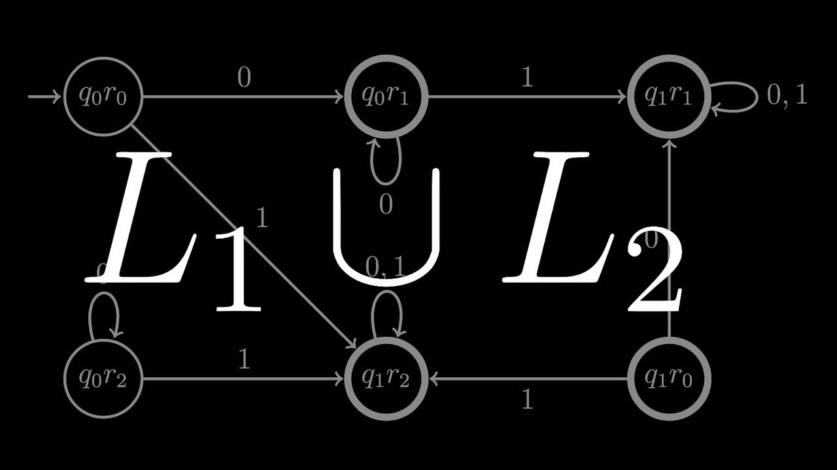
Closure Under Union
Automatic compile and design systems should exhibit closure under union, meaning that the union of any two elements in the system should also be in the system.
This property ensures that combining different components or operations in the system will not result in any unexpected behavior or errors.
Closure under union is essential for maintaining the integrity and consistency of the system.
Notes:
Image source: https://www.youtube.com/watch?v=g3NMLcAxQ7k

Slide 4
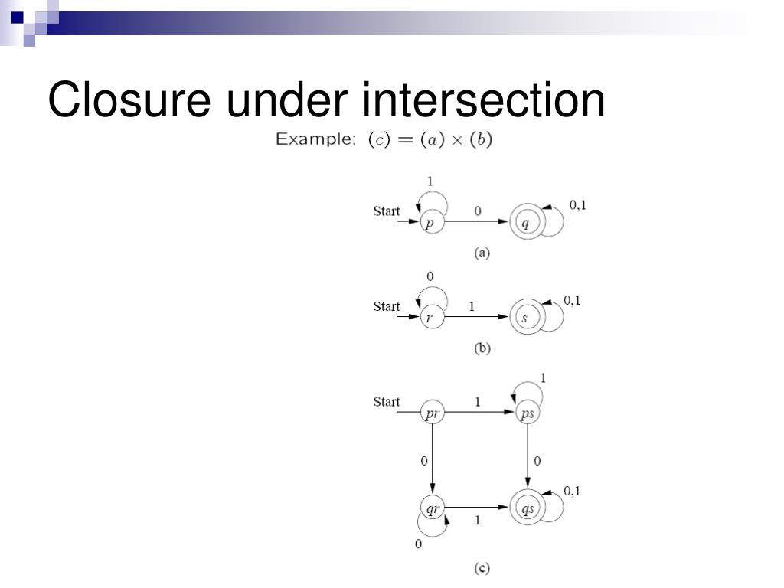
Closure Under Intersection
Another important closure property is closure under intersection, where the intersection of any two elements in the system should also be in the system.
This property allows for efficient optimization and simplification of design processes by ensuring that common elements are preserved.
Closure under intersection helps in reducing redundancy and improving the overall performance of the system.
Notes:
Image source: https://www.slideserve.com/lajos/closure-properties-for-regular-languages

Slide 5
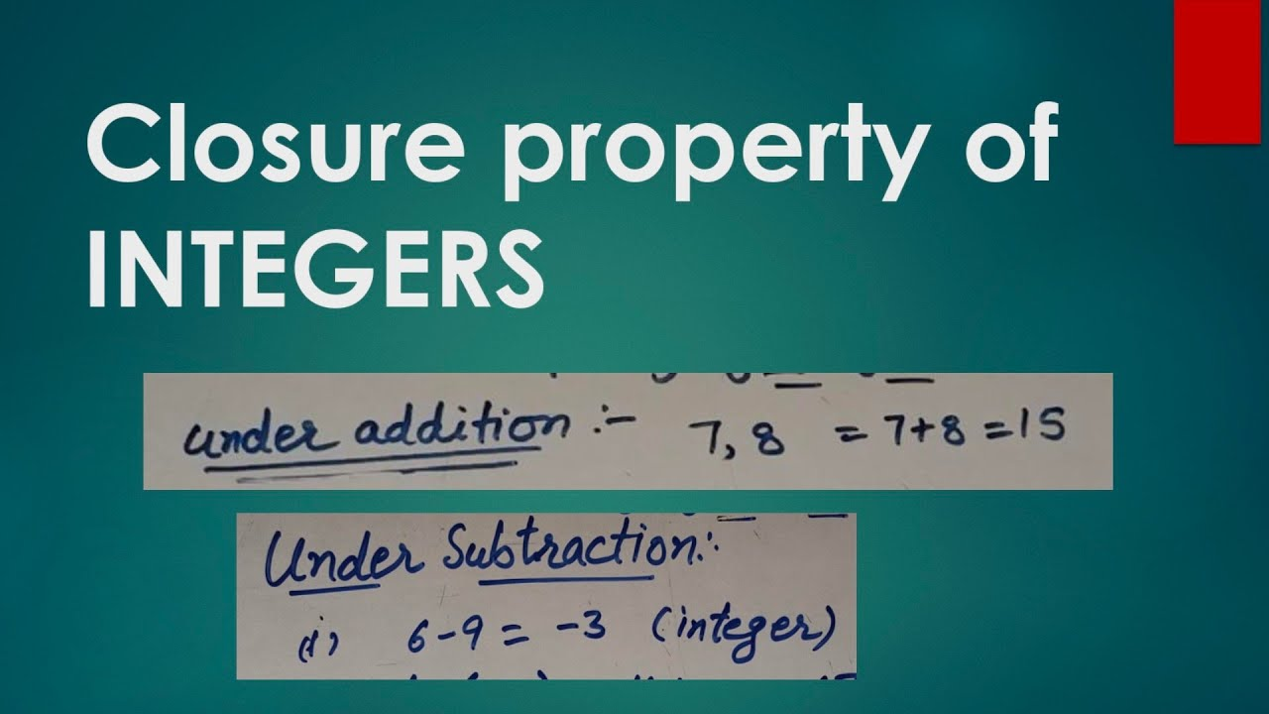
Closure Under Complementation
Closure under complementation is the property that any element in the system should also have its complement in the system.
This property is crucial for enabling the system to handle negation or inversion operations effectively.
Closure under complementation ensures that the system remains versatile and adaptable to various design requirements.
Notes:
Image source: https://www.youtube.com/watch?v=Sw2MBZXf30k

Slide 6
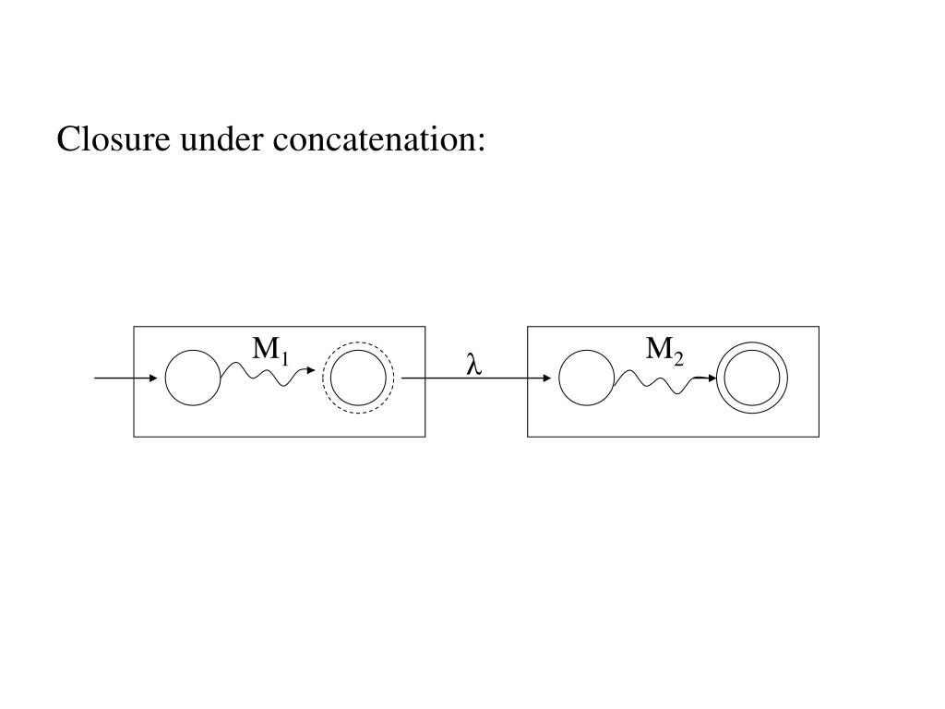
Closure Under Concatenation
Automatic compile and design systems should exhibit closure under concatenation, meaning that the concatenation of any two elements in the system should also be in the system.
This property is essential for building complex designs by combining smaller components or operations seamlessly.
Closure under concatenation enables the system to scale effectively and handle intricate design structures efficiently.
Notes:
Image source: https://www.slideserve.com/ramona-wynn/chapter-3-regular-languages-and-expressions

Slide 7

Conclusion
Closure properties play a vital role in the automatic compile and design processes by ensuring consistency, reliability, and efficiency.
By understanding and leveraging these properties, designers and developers can streamline their workflows and optimize system performance.
Emphasizing closure properties in automatic compile and design is key to achieving robust and scalable systems in the modern technological landscape.
Notes:
Image source: https://www.medlern.com/digital-tools-play-vital-role-in-improving-patient-care/

